Slide 1
R User Group
Building a community of R users in Connecticut state government
July 14, 2025

Slide 2
Agenda
R-users group #tidytuesday Show & Tell!

Slide 3
R User Group #TidyTuesday Challenge

Slide 4
R User Group #TidyTuesday Challenge
Explore Electric Vehicle Trends in Connecticut
📊 Using Open Data: EV Registration Data
Explore, analyze, and visualize the EV registration data using R
Bring your work to the July R User Group meeting to share!
Why Join?
Practice using R, data viz, & storytelling
Use real CT open data
Build your skills with the R community
Low-pressure & fun!

Slide 5

Want more #TidyTuesday?
We’re doing one #TidyTuesday challenge this summer, but the wider R community participates in #TidyTuesday on a weekly basis.
Every Tuesday, a new dataset is posted on GitHub for anyone to explore, analyze, and visualize using tidyverse tools.
Check out #TidyTuesday on social media to see other R users’ work.

Slide 6
About the dataset
This dataset includes all new electric vehicles registered in Connecticut from 1/1/2021 to the most recent data available. The data is updated bi-annually.
60,489 rows: Each row is a registered electric vehicle
20 columns: These represent details about the vehicle (vehicle type, primary color, registration date, expiration date, etc.)
ID | Plate Type | Primary Customer City | Primary Customer State | Registration Start Date | Registration Expiration Date | Registration Usage | Vehicle Type | Vehicle Weight | Vehicle Year | Vehicle Make | Vehicle Model
13 | Passenger | GLASTONBURY | CT | 2/17/2023 | 2/16/2026 | Regular | SUV | 0 | 2023 | Tesla | Model Y
19 | Passenger | ORANGE | CT | 2/23/2023 | 2/22/2026 | Regular | SUV | 0 | 2023 | Jeep | Wrangler Sahara 4xe
21 | Passenger | LITCHFIELD | CT | 2/23/2023 | 2/22/2026 | Regular | SUV | 0 | 2023 | Tesla | Model Y
73 | Passenger | NORWALK | CT | 2/20/2023 | 2/19/2026 | Regular | SUV | 0 | 2023 | Hyundai | Ioniq 5 Limited
126 | Passenger | SOUTHINGTON | CT | 2/18/2023 | 2/17/2026 | Regular | Passenger | 0 | 2023 | Hyundai | Ioniq 5 Sel
164 | Passenger | MANCHESTER | CT | 2/16/2023 | 2/15/2026 | Regular | SUV | 0 | 2023 | Toyota | Rav4 Prime Xse
205 | Passenger | GUILFORD | CT | 2/10/2023 | 2/9/2026 | Regular | SUV | 0 | 2016 | Tesla | Model X

Slide 7
Show & Tell

Slide 8
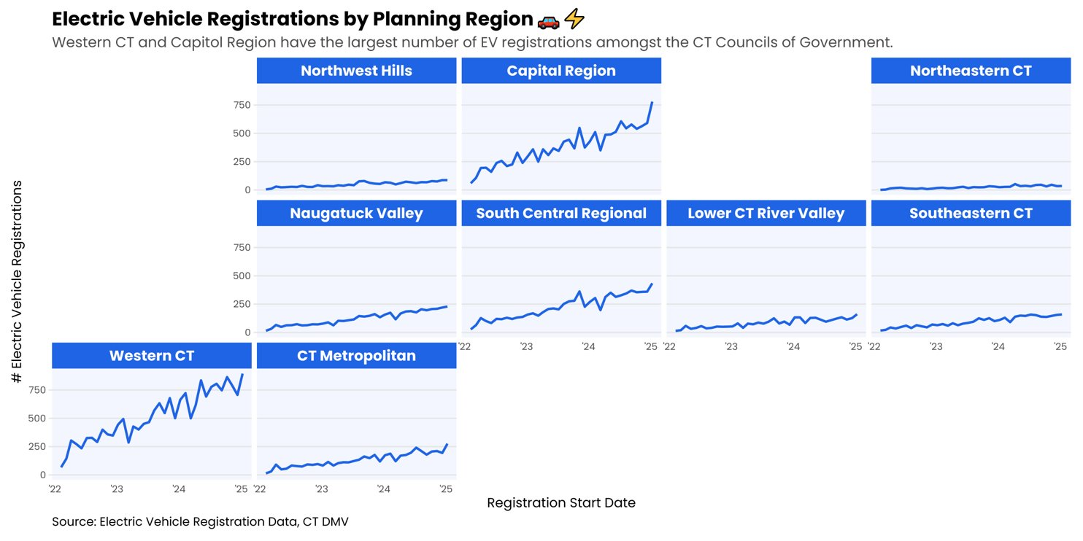
Pauline Zaldonis

Slide 9
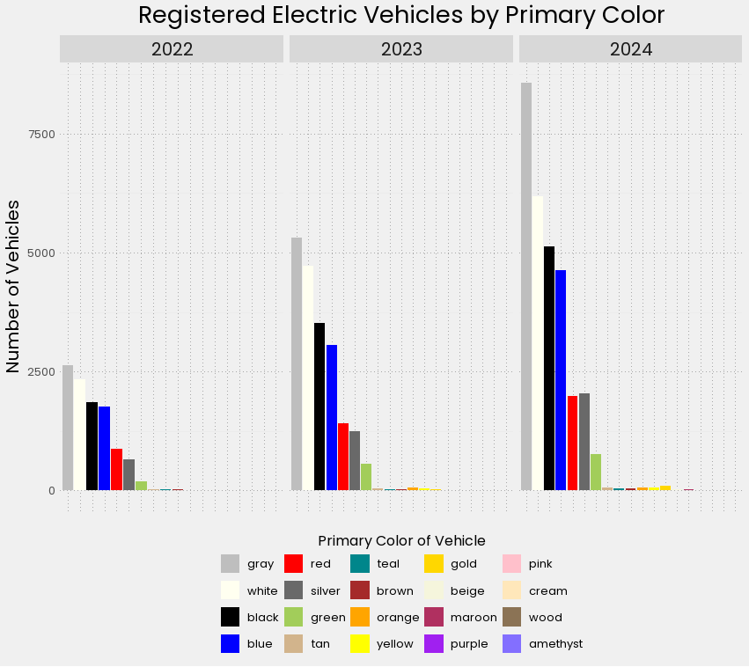
Sarah Hurley

Slide 10
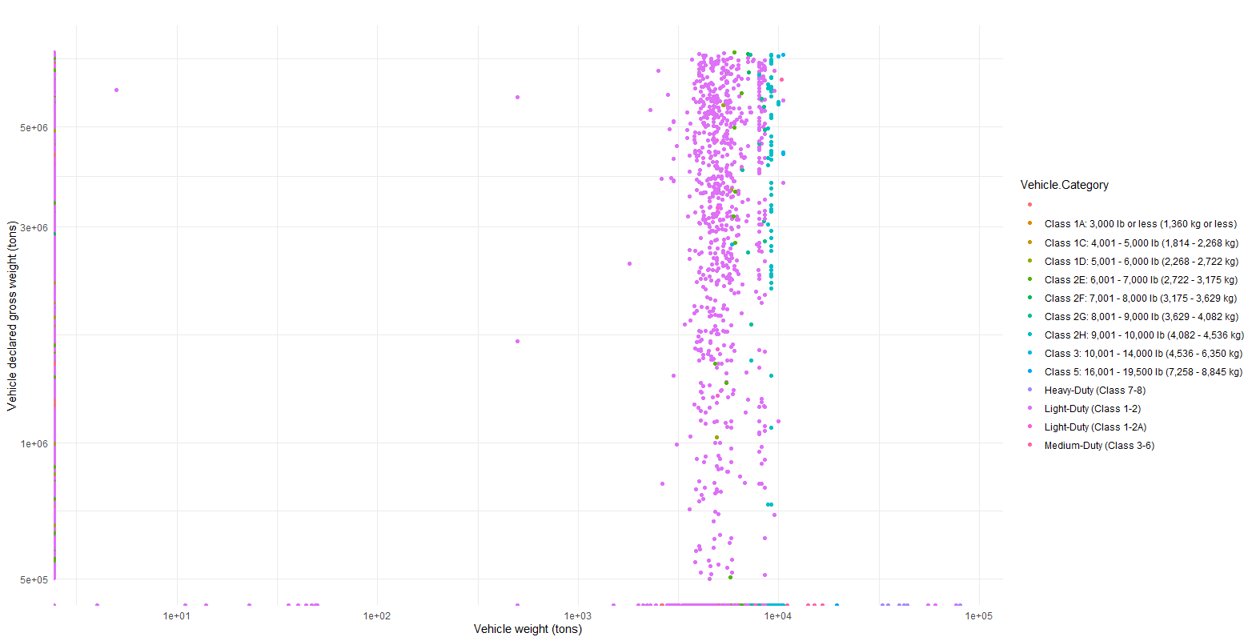
Fig 1, Xun Che

Slide 11
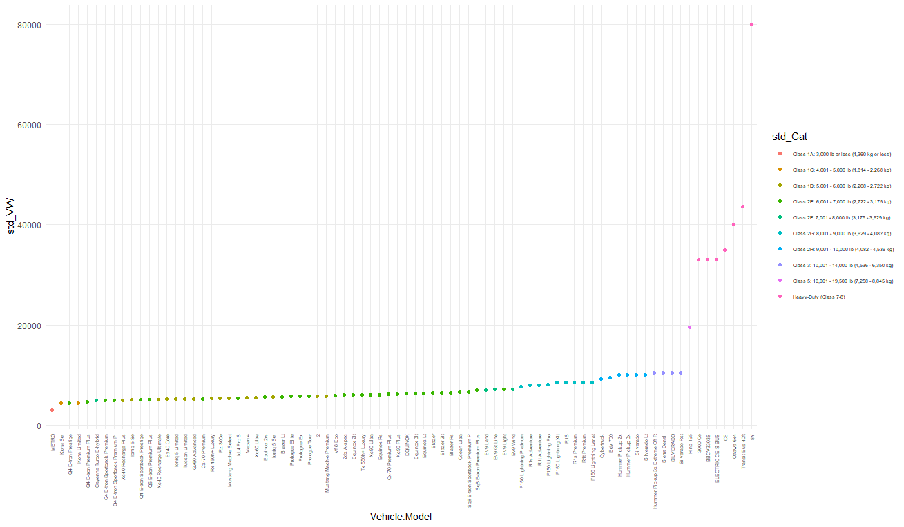
Fig 2, Xun Che

Slide 12
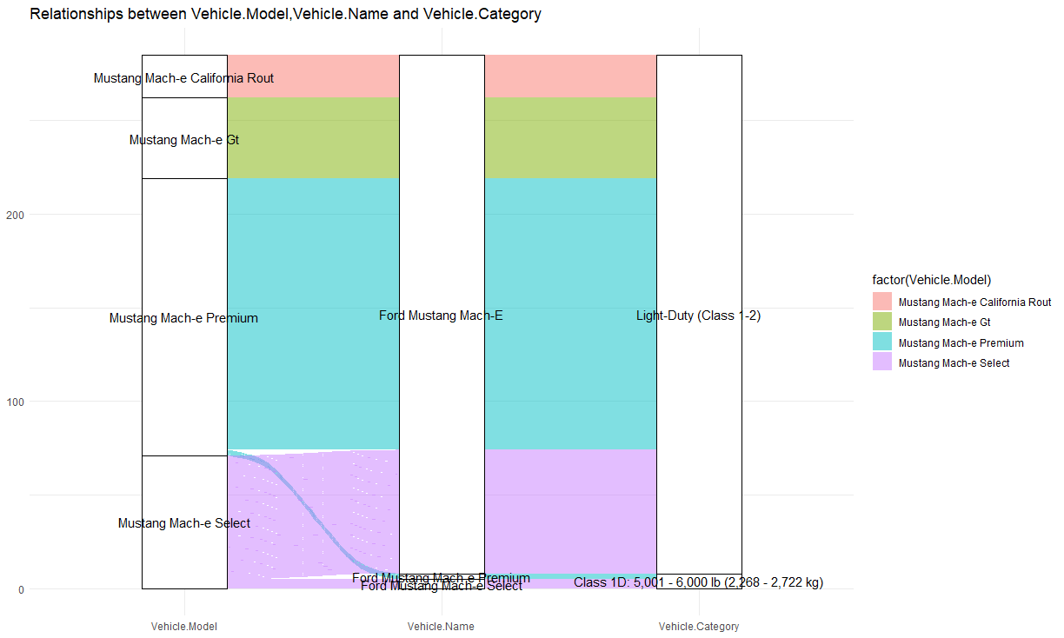
Fig 3, Xun Che

Slide 13
Julia Healey-Parera

Slide 14
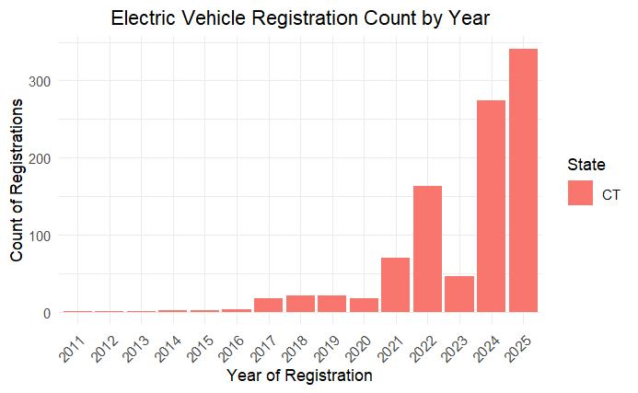
Leah Hodges

Slide 15
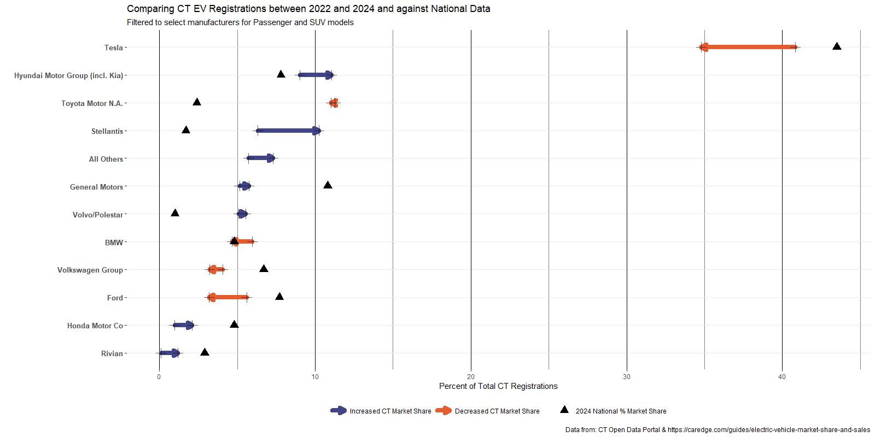
Chuck Powell

Slide 16
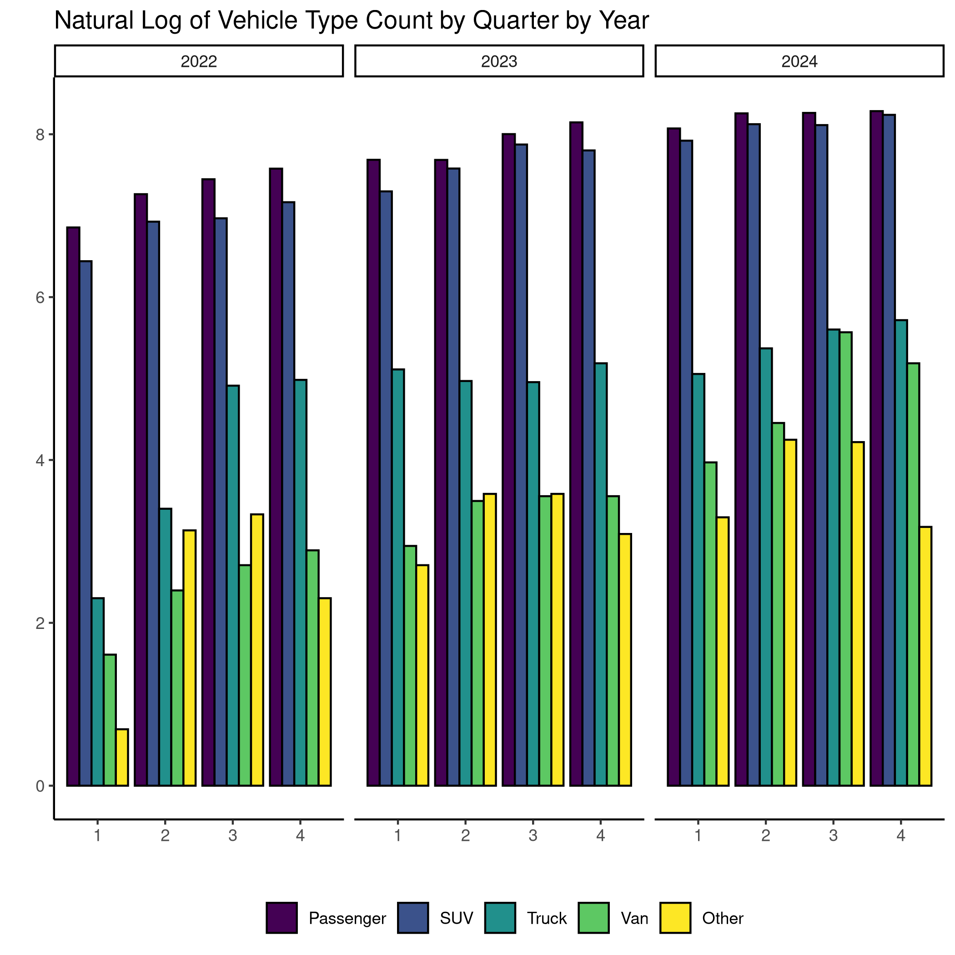
Alex Senetcky

